Slide 1
Conceptual Modeling and
E-R Diagram
COMP3010E Fall 2025
Lecture 2

Slide 2
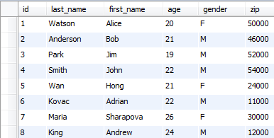
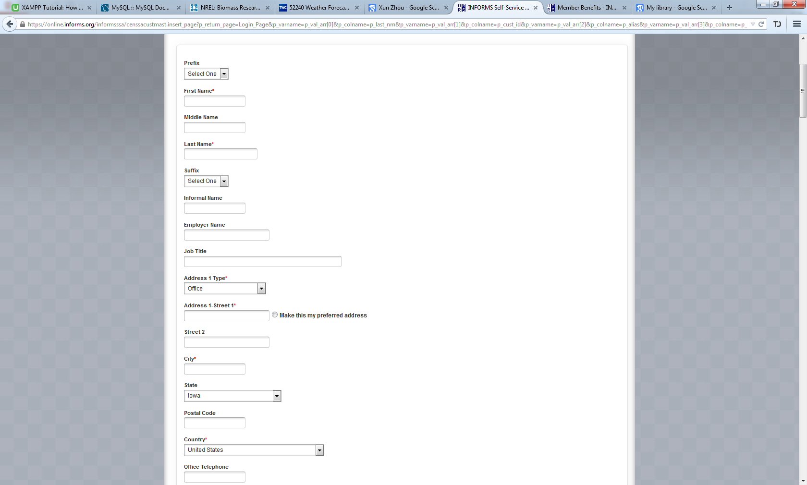
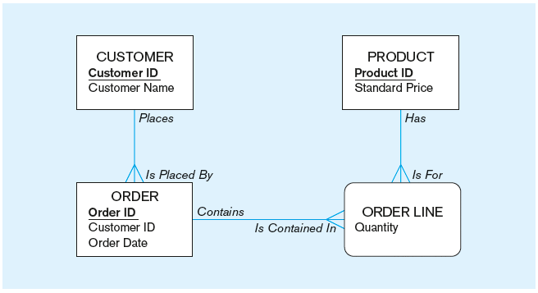
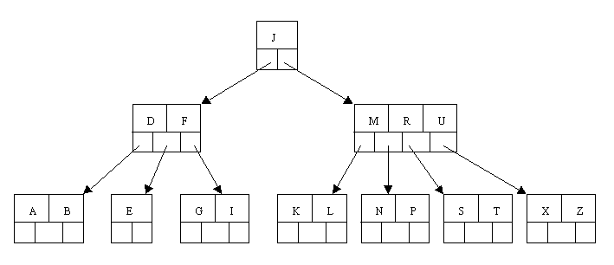
Quick Review
Concepts: Data, Information, Meta Data, Database, DBMS, Repository
Traditional File Processing vs. Database Approach
Database architecture: 3 schema, external, conceptual/logical, physical
Database ranges: personal, two-tier, three and multi-tier, ERP and Data Warehouse
External Schema
App 1
App 2
App 3
Conceptual/Logical
Schema
Model/Relational Tables
Physical Schema

Slide 3
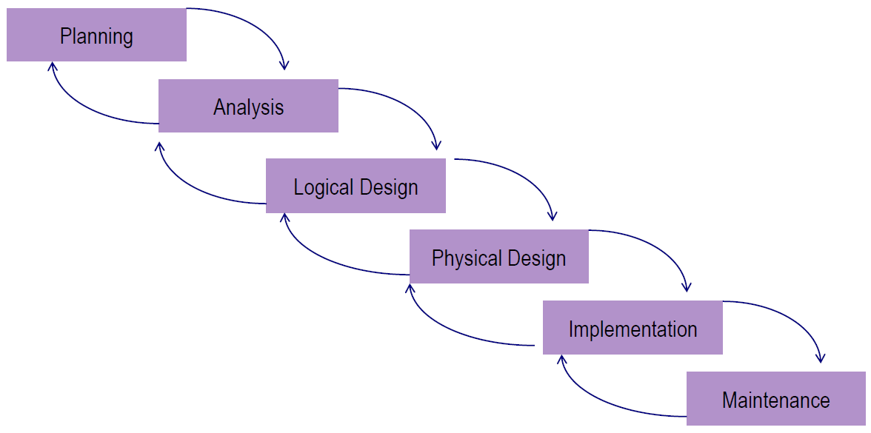
Systems Development Life Cycle (SDLC)
  Develop a preliminary understanding
  Analyze the business situation thoroughly
  Generate a logical representation of data
  Develop physical organization of data
  Perform database implementation
  Monitor/repair and enhance the system

Slide 4
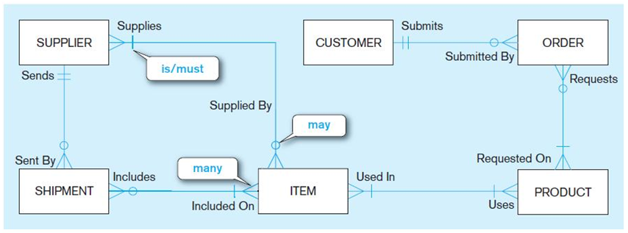
Data Modeling
Conceptual Model
  Capture the nature of relationships among data
  It is about understanding the business rules and the requirements
Logical Model
  Transform the conceptual model into a logical representation of data
  It is about creating the database structure (e.g., tables in relational data model)
Physical Design
  Translate the logical model into technical specifications for storing/retrieving data
  It is about storing data to achieve data processing efficiency and data quality
CUSTOMER
ID | Name | Address
101 | David Hills | …
102 | Mary Lee | …
Index and file organization on disk

Slide 5
Conceptual Modeling
Input: business rules
Output: An E-R diagram

Slide 6
Business Rules
Foundation of data models
Definition: a statement that defines or constraints some aspect of the business
Formalize the understanding of the business
Govern how data are handled and stored
Example: In UI Course System (Business Rules)
Each STUDENT is identified by a StudentID number. We also keep their names, gender, DOB,
major, address…
Each COURSE is identified by a course number. We also record their time, location, credits.
Each student may take zero or many courses. Each course must be taken by one or many students.

Slide 7
Business Rules
Terms and Facts
  Term: a word or phrase representing a data object of interest
  Fact: an association between two or more terms
Not always explicitly indicated
  business policies, operational procedures, technical instructions, etc.
Your job as a database designer or analyst is to
  Gather those business rules
  Represent them in your conceptual model
  Implement them in your database system

Slide 8
Business rules for Facebook
User, Post, Friends
  User: ID, Name, DOB, Gender, …
  Post: ID, Title, Time, Content
A user may post any number of posts
A post is posted by exactly one user
Friendship?
  A user may be a friend of many other users, or has no friend.

Slide 9
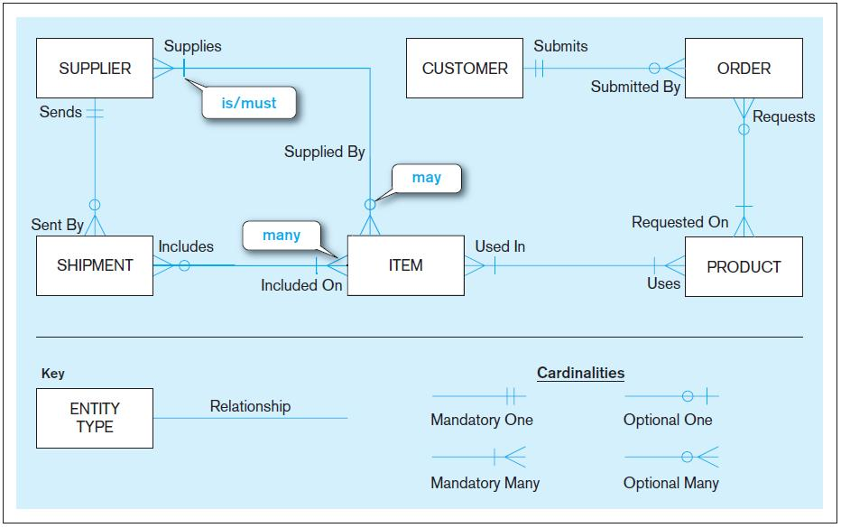
Entity-Relationship Diagram
E-R diagram (ERD):
a graphical
representation of
an E-R model
Two components
  Entities
  Relationships

Slide 10

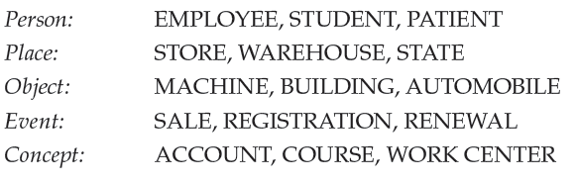
Entity
Definition
  Data object of importance in the user/business environment
  The organization wishes to maintain the data of the object
  Many instances sharing common characteristic and distinguishable from each other
Examples
STUDENT
I’m Bob

Slide 11
Entity Type vs. Entity Instance
Entity Type
  A collection of entities that share common properties or characteristics
  Named by a singular noun and indicated by CAPITAL letters
  Placed inside a box in an E-R diagram, e.g.,
Entity Instance
  A single occurrence of an entity type
  Many instances of one entity type
  Distinguishable from each other
Note
  Use entity for entity type/instance
  when no confusion in the context
STUDENT
COURSE
EMPLOYEE
Employee ID | Name | Date Hired | Birth Day
642-17-8360 | Michelle Brady | 03-21-1992 | 06-19-1968
534-10-1971 | David Johnson | 08-16-1994 | 09-04-1975

Slide 12
Attributes
Definition
  A property or characteristic of an entity (or relationship) type
  It is of interest to the user/organization
Naming convention
  An attribute name is a singular noun or noun phrase
  Initial capital letter followed by lowercase letters (for each word)
Examples
  STUDENT: Student ID, Name, Gender, Home Address, Major
  AUTOMOBILE: Vehicle ID, Make, Model, Color, Weight
In E-R diagrams
  Place an attribute’s name in the box of the entity type with which it is associated
STUDENT
Student ID
Name
Gender
Home Address
Major

Slide 13
Required vs. Optional Attributes
Required attribute
  Must have a value for each entity instance of the entity type
Optional attribute
  May not have a value for some entity instances
required
optional
STUDENT
Student ID | Name | Home Address | Major
876-24-8217 | Michael Grant | 314 Baker St, Coralville, IA 52241 | MIS
822-24-4456 | Mellissa Kraft | 1622 10th Ave, Iowa City, IA 52246

Slide 14
Simple vs. Composite Attributes
Simple attribute
  Atomic
  Cannot be broken down into smaller components (e.g., Age, Gender, Color)
Composite attribute
  Has meaningful component parts
  e.g., Name (First Name, Last Name), Home Address (Street Address, City, State, Postal Code)
  Sub-divide it only when necessary
Other examples?
STUDENT
Home Address
Student ID | Name | Street Address | City | State | Zip Code | Major
876-24-8217 | Michael Grant | 314 Baker St | Coralville | IA | 52241 | MIS
822-24-4456 | Mellissa Kraft | 722 Riverside Dr | Peoria | IL | 61601

Slide 15
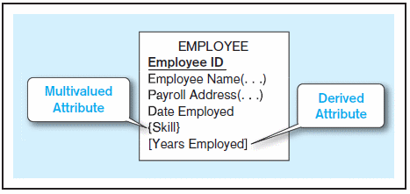
Multivalued and Derived Attributes
 | Phone Number
Multi-valued | (319)-384-3335 (319)-335-1234 ….
Composite | Area code: 319 Local: 384-3335
Single-valued attribute
  Has ONE single value for each entity instance (e.g., Age, Gender)
Multivalued attribute
  May take on more than one value for a given entity instance
  Such as Skill attribute in the EMPLOYEE entity type (e.g., Java, C++)
  Indicated with curly brackets in ERD
Derived attribute
  Calculated from related attribute values
  e.g., Years Employed = Today’ date – Date Employed
  Indicated with square brackets in ERD
Multivalued attribute vs. composite attribute

Slide 16
Identifier Attribute (1)
Definition
  An attribute (or combination of attributes) that uniquely identifies instances of an entity type
  e.g., Student ID for STUDENT
Marked with an underline in ERD
Can we use student Name as the identifier?
STUDENT
Student ID
Name
Gender
Home Address
Major
required or optional attribute
simple or composite attribute
Identifier attribute
Single-valued or multivalued attribute
stored or derived attribute

Slide 17
Identifier Attribute (2)
Candidate identifier
  An entity may have multiple candidate identifiers
  e.g., Student ID, SSN, Driver License, or UI Email Address for STUDENT
How to make your selection?
  Will not change its value
  Guaranteed to have a valid (not null or unknown) value
  Single-attribute, surrogate identifier better than long, composite identifier
  e.g., Game Number better than (Home Team + Visiting Team + Game Date)

Slide 18
Attribute Types: Summary
 |  | Definition
Required | Optional | Must have value? Or can have missing value?
Simple | Composite | Can be further divided into sub-attributes?
Single-Valued | Multi-Valued | Can have multiple values?
Stored | Derived | Come from data directly? Or calculated from data?
Preferred
Not a must
Identifier attribute

Slide 19
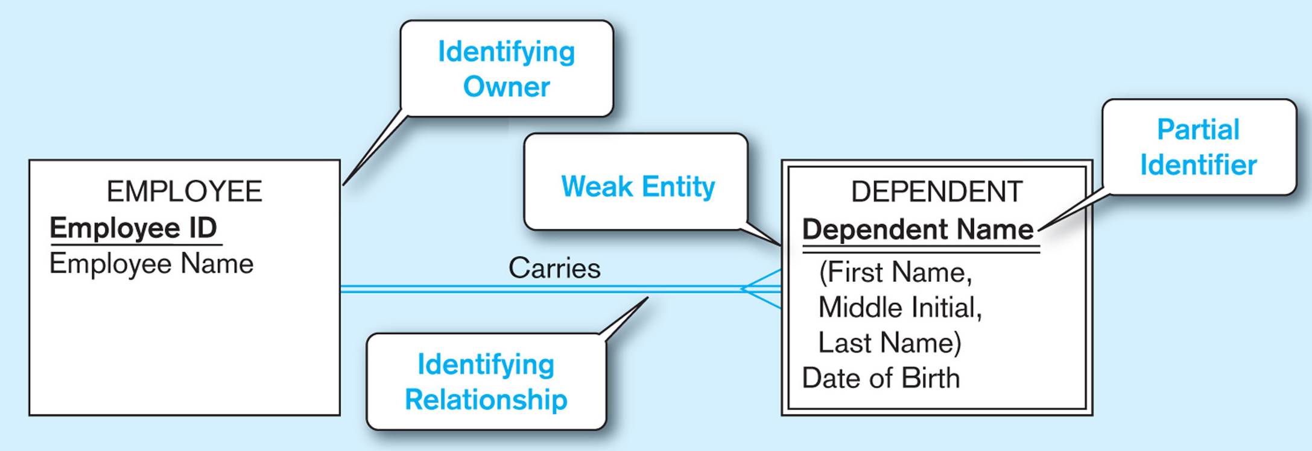
Strong vs. Weak Entity Types
Strong entity type
  Exist independently of other entities
  Most entity types are strong ones
  e.g., STUDENT, COURSE, EMPLOYEE, ORDER, PRODUCT
Weak entity type
  Whose existence depends on some other entity type
  No business meaning without the entity type on which it depends
  No identifier of its own, but a partial identifier
Double lines
Other examples?
COURSE vs. SECTION

Slide 20
Quick Exercise - Facebook E-R Diagram
Draw two entities: User and Post
First describe the business rules
User: has UserID, Name (first and last names), DOB, Gender, Years_Joined
Post: PostID, Title, PostTime, Content, and a number of “Tags”
USER
UserID
Name (First, Last)
DOB
Gender
[Years_Joined]
POST
PostID
Title
PostTime
Content
{Tags}

Slide 21
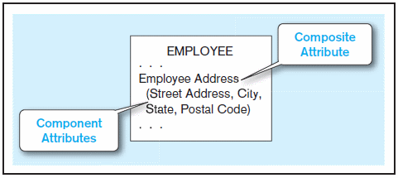
Review: ER Diagram 1
Entity: Person, Location, Events, Objects, etc
Name: singular noun (phrase), CAPITAL, top-center of box
Attributes: singular noun/noun phrase, initial letter Capitalized
  Required vs Optional
  Simple vs. Composite (att1, att2, …)
  {Multi-valued} vs. Single-valued
  Stored vs. [Derived]
  Identifying attribute: Required, Single-Valued
  simple (preferred), stored
Example of multi-valued, composite attribute?
Phone number (see last lecture note)

Slide 22
Strong vs. Weak Entity Types
Strong entity type
  Exist independently of other entities
  Most entity types are strong ones
  e.g., STUDENT, COURSE, EMPLOYEE, ORDER, PRODUCT
Weak entity type
  Whose existence depends on some other entity type
  No business meaning without the entity type on which it depends
  No identifier of its own, but a partial identifier
Double lines
Other examples?
COURSE vs. SECTION

Slide 23
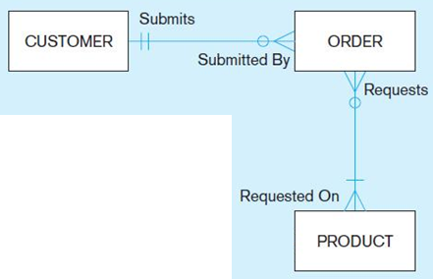
Entity-Relationship Model
Entity type
Attributes: identifier, required/optional, simple/composite, etc.
What is missing?
Relationship

Slide 24
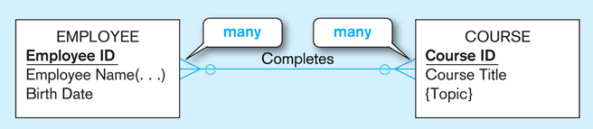
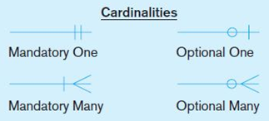
Relationships
Define meaningful association among related entity types
Connecting Entity types
Each relationship incorporates two business rules, one for each direction
  e.g., for the “Completes” relationship,
  An EMPLOYEE may complete any number of COURSEs;
  A COURSE may be completed by any number of EMPLOYEEs
optional

Slide 25
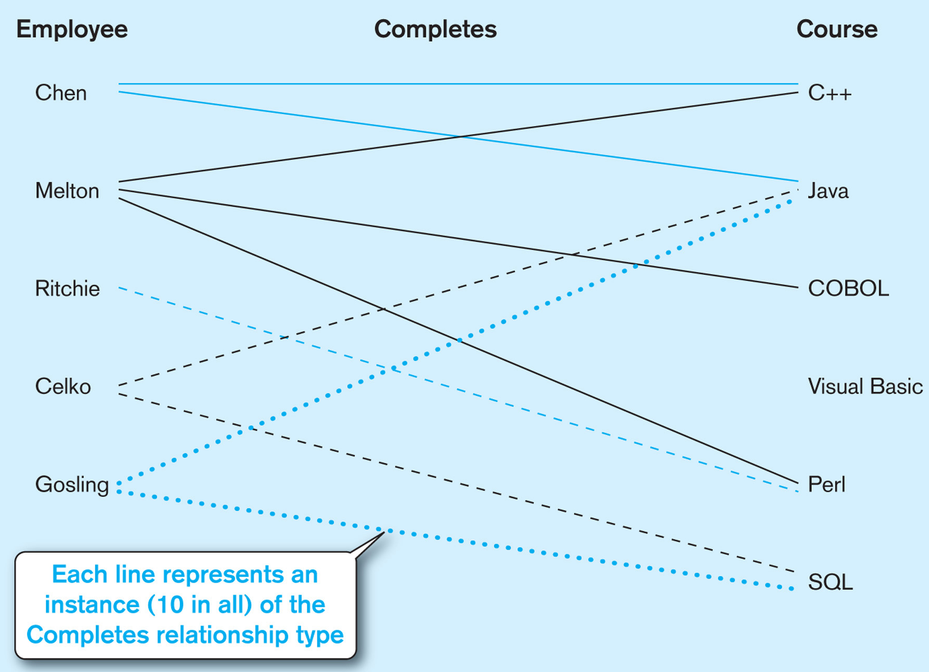
Relationship Type vs. Instance
Relationship “Type”
  A meaningful association between (or among) entity types
  Named by a verb or verb phrase
  Denoted by a line labeled with its name
Relationship Instance
  An association between (or among) entity instances
  Many instances of one relationship type
  Distinguishable from each other

Slide 26
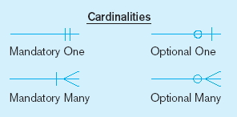
Cardinality Constraints (1)
Definition
A rule that specifies the number of instances of one entity that may or must be associated
with each instance of another entity
e.g., A student may register for zero or many courses, and
each course must be registered by one or more students
Minimum Cardinality
  Minimum number of instances of one entity (B) associated with each instance of another entity (A)
  If zero, entity B is optional
  If at least one, entity B is mandatory
Maximum Cardinality
  Maximum number of instances of one entity (B) associated with each instance of another entity (A)
  If one, entity B is “One”
  If more than one (any number), entity B is “Many”

Slide 27
E-R Model
Maximum
cardinality
An example of E-R diagram
Course
CourseNumber
Time
Location
Credits
Student
StudentID
Name
Gender
DOB
Major
Address
takes
Taken by
Minimum
cardinality
zero
Faculty
FacultyID
Name
Office
one
many

Slide 28
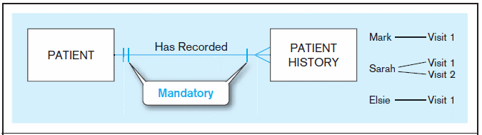
Cardinality Constraints (2)
Remember: a relationship incorporates 2 business rules (and so is bidirectional)
Mandatory-one to mandatory-many
A patient history must be recorded for one and only one patient
Each patient must have recorded at least one history, and can have many

Slide 29
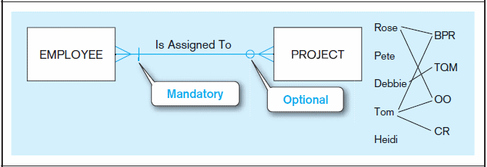
Cardinality Constraints (3)
Mandatory-many to optional-many
Each project must be assigned to at least one employee, and may be assigned to many
An employee can be assigned to any number of projects, or may not be assigned to any at all (e.g., Pete and Heidi)

Slide 30

Cardinality Constraints (4)
You may specify specific min/max cardinalities
Each project must be assigned to at least TWO employee, and may be assigned to many employees
An employee can be assigned to at most THREE projects, or may not be assigned to any at all

Slide 31
Classification of Relationships
1:1 One-to-one
1:M One-to-Many
M:N Many-to-Many
This is a simplified way to represent relationships
Only based on maximum cardinality
Ignore minimum cardinality

Slide 32
Degree of Relationships
The number of entity types that participate in the relationship
Types
  Unary relationship (degree 1)
    Between instances of a single entity type
  Binary relationship (degree 2)
    Between instances of two entity types
    Most common type of relationship
  Ternary relationship (degree 3)
    A simultaneous relationship among the instances of three entity types
    Not the same as three binary relationship

Slide 33

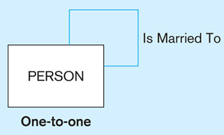
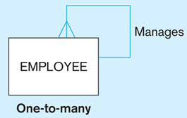
Unary Relationship
Involve a single participating entity type
1. <A PERSON> <Is Married To> <another PERSON>
2. <An EMPLOYEE> <Manages> <one or more EMPLOYEEs>
Other examples?
<A PERSON> <Make Friends With> <another PERSON>
<A TEAM> <Competes With> <another TEAM>

Slide 34

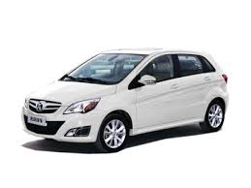
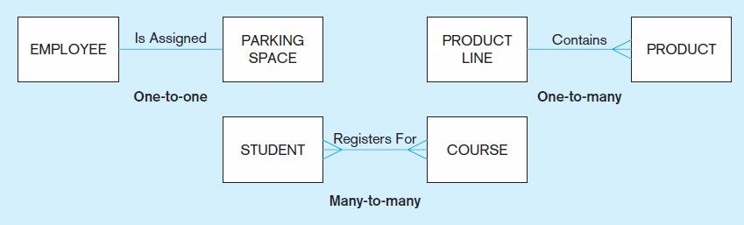
Binary Relationship
Involve two participating entity types
  <An EMPLOYEE> <Is Assigned> <one PARKING SPACE>
  <A PRODUCT LINE> <may Contain> <several PRODUCTS>
  <A STUDENT> <must Register For> <one or more COURSEs>

Slide 35
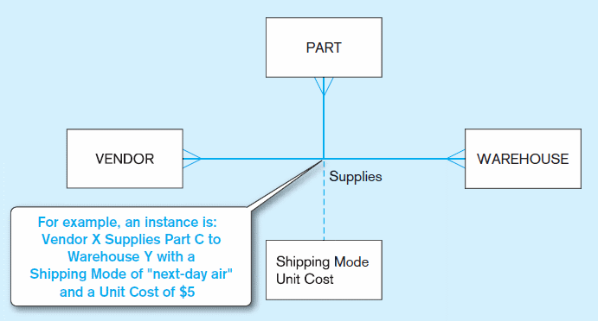
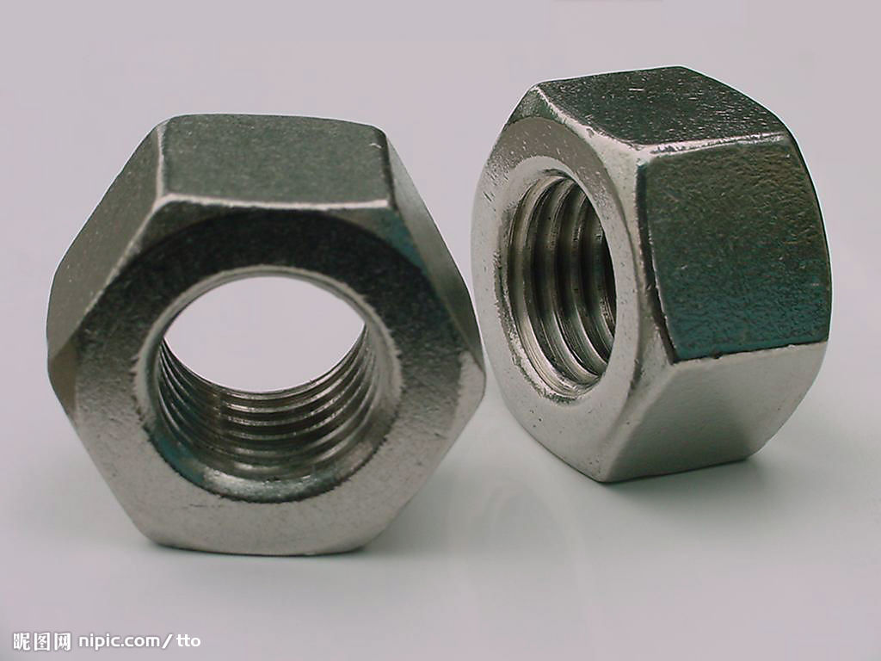

Ternary Relationship (1)
Involve three participating entity types simultaneously
e.g. <A VENDOR> <Supplies> <several PARTs> <to WAREHOUSEs>
Other examples?
<A CUSTOMER> <Buys> <PRODUCTs> <from STOREs>
<A DOCTOR> <Prescribes> <Drugs> <to PATIENTs>

Slide 36
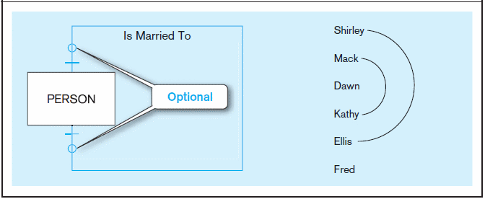
Cardinality Constraints (5)
Optional-one to optional-one
A person is married to at most one other person, or may not be married at all

Slide 37
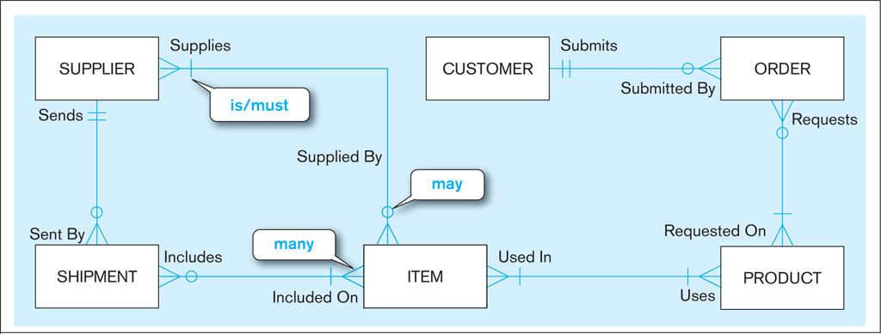
Exercise

Slide 38
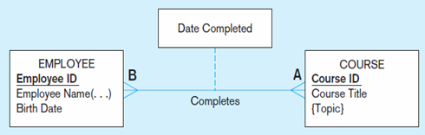
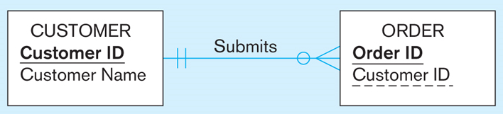
Relationship Attributes
Relationship can also have attributes
  A property pertaining to the relationship instances
  Rather than a property of either entity type
Example
  EMPLOYEE <Completes> COURSE
  Completes : (Date Completed, Grade)
Associated with
  Many-to-many relationship
  One-to-one relationship (an example?)
Why not associated with one-to-many relationships?

Slide 39
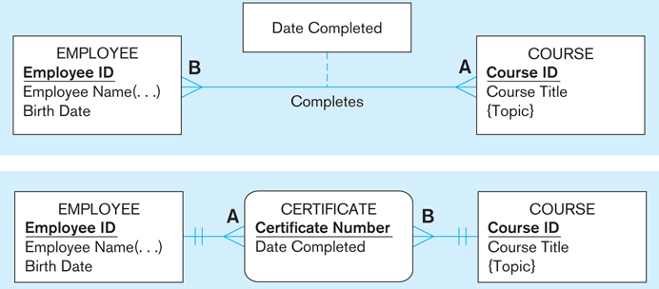
Associative Entity (1)
Definition
  Associate the instances of one or more entity types
  Contain attributes that are peculiar to the relationship instances
Notation
  Rectangle with rounded corners
  Two one-to-many relationships
  No relationship names
  between the associative entity
  and either strong entity

Slide 40
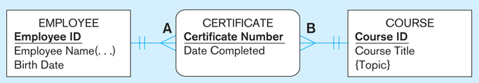
Associative Entity (2)
A relationship or an associative entity type?
General guidelines
  The relationship is many-to-many (M:N)
  Has independent meaning to end users
  Has one or more attributes besides a single-attribute identifier
  May participate in one or more relationships with other entities
  Ternary relationships should be converted to associated entities

Slide 41
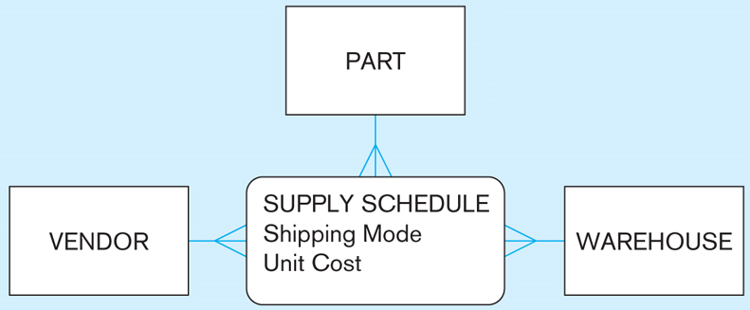
Ternary Relationship (2)
Cannot be replaced with 3 binary relationships
  Takes place among 3 entity types simultaneously
  Attributes of the ternary relationship cannot be properly
  associated with any one of the 3 binary relationships
Convert to an associative entity type
  Add one simple identifier
  No identifier. Identified by (VendorID+PartID+WarehouseID)
  Attributes

Slide 42
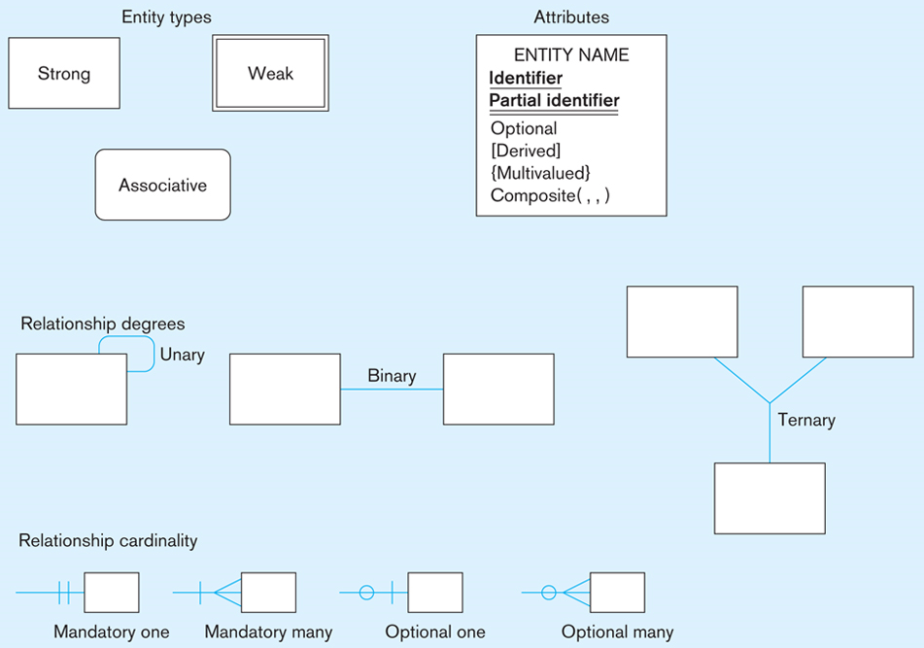
ERD Review

Slide 43
Exercise (Textbook Chapter 2 Q.24(e))
A piano manufacturer wants to keep track of all the pianos it makes individually..
Each piano has an identifying serial number and a manufacturing completion date.
Each instrument represents exactly one piano model, all of which have an identification number and a name.
In addition, the company wants to maintain information about the designer of the model.
Over time, the company often manufactures thousands of pianos of a certain model, and the model design is specified before any single piano exists.

Slide 44
